Slide 1
DGAs and Threat Intelligence
John Bambenek – Fidelis Cybersecurity Threat Research Team
HITCON 2015

Slide 2
Intro
Sr. Threat Analyst for Fidelis Cybersecurity
Adjunct Faculty in CS Department at the University of Illinois at Urbana-Champaign
Producer of open-source intel feeds
Work with companies and LE all over the world to address growth in cybercrime

Slide 3
About Threat Intelligence
Information is a set of unprocessed data that may or may not contain actionable intelligence.
Intelligence is the art of critically examining information to draw meaningful and actionable conclusions based on observations and information.
Involves analyzing adversary capabilities, intentions and motivations.

Slide 4
Adversarial objectives
Here we are generally talking about organized crime, usually financially motivated.
What we know:
Highly rational actors
May hire “outside experts” for specific tasks
Generally technological sophisticated
Desire to remain “quiet” and resilient

Slide 5
My Objectives
Any good intelligence program needs to also analyze your own objectives.
I investigate and try to disrupt criminal networks, so my objective is externally focused.
These efforts are directed toward “criminal” actors, nation-state / APT threats would require a different focus.
Most people are defensively focused so their information priorities are different.

Slide 6
Malware C2 Network Types
Static IP / Hostname Lists
Proxied C2s
Dynamic DNS
Fast Flux / Double Flux Networks
Domain Generation Algorithms
Tor / i2p hidden services

Slide 7
A History of Malware C2 Networks
An adversary wants to persist over the long-term and make their networks more resilient against enforcement actions.
Domains tend to be easier to take down the IPs due to avoidance of jurisdictional issues.
Development over time will largely show adversaries have acted in ways to ensure increased resiliency.
We can continue to map forward over time where they are likely to go in the future as a result.

Slide 8
Use of Multiple Techniques
The most resilient malware C2 use multiple methods of callback.
Static Lists
DGAs
Tor/I2P
If one or two are blocked, still able to control machine.
To affect a takedown, need to block all means of communication and updating victim machines.

Slide 9
Domain Generation Algorithms
Usually a complex math algorithm to create pseudo-random but predictable domain names.
Now instead of a static list, you have a dynamic list of hundreds or thousands of domains and adversary only needs to have a couple registered at a time.
Can search for “friendly” registrars to avoid suspension.

Slide 10
Reverse Engineering DGAs
Many blog posts about reversing specific DGAs, Johannes Bader has the most online at his blog:
Johannesbader.ch
No real shortcuts except working through IDA/Debugger and reversing the function.
Look for functions that iterate many times.
There will be at least a function to generate the domains and a function to connect to all of them to find the C2.
As with all reverse engineering, be aware of obfuscation and decoy code meant to deceive you.

Slide 11
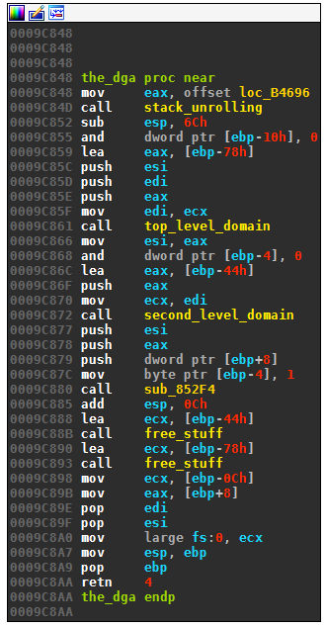
Reversing DGAs Example
From http://johannesbader.ch/2015/05/the-dga-of-ranbyus/

Slide 12
Types of DGAs
Almost all DGAs use some time of “Seed”.
Types:
Date-based
Static seed
Dynamic seed
Seed has to be globally consistent so all victims use the same one at the same time.

Slide 13
Other DGA Hardening Techniques
Choice of gTLD matters.
Some doing have WHOIS protection, make it hard to sinkhole
Rotation of seeds
Some malware has rudimentary “sinkhole awareness”
Adversarial objectives: Maintain control, limit surveillance

Slide 14
Examples of select DGAs - Cryptolocker
Used 1000 domains a day across 7 gTLDs. Order domains are queries in based on GetTickCount()
Eerily similar to DGA described in Wikipedia article on DGAs.
Used previously by Flashback OSX Worm.
Never changed during the life of the malware campaign.
Successfully taken down in June 2014.
Special thanks to Vladimir Kropotov for his help on this!

Slide 15
Examples of select DGAs - Cryptolocker
Intel conclusions:
Likely written by a third party.
Went days without a domain registered, actor wanted to get paid but wasn’t overly concerned about keeping everything going 24x7.
Tended not to shift registrar even after domains were suspended.
Likely didn’t monitor his own domains because the ratio of malicious to sinkholed domains was about 1:125.
Way to go on the OPSEC good guys. ☺D

Slide 16
Examples of select DGAs - Tinba
Generated 1,000 domains a day, not date-seeded.
Seeded by an initial hostname and a defined gTLD (one or more).
Changes seeds often and tends to update already infected machines.
At least sinkholing tended to be ineffective for more than a few days.

Slide 17
Examples of select DGAs - Tinba
Intelligence conclusions:
These guys care about their infrastructure.
Likely they are actively monitoring to see when their DGA is cracked and adapting accordingly.
Likely they wrote DGA with this kind of flexibility in mind.

Slide 18
Examples of select DGAs - Bedep
Uses a dynamic seed – currency exchange values for foreign currency
European Central Bank produces daily feeds of the rates, this is used as source data.
Impossible to predict in advance even though code to generate the domains is publicly available.
http://asert.arbornetworks.com/bedeps-dga-trading-foreign-exchange-for-malware-domains/

Slide 19
Examples of select DGAs - Bedep
To date, all successful takedowns (and for that matter unsuccessful takedowns) seized malicious DGA domains in advance while simultaneously suspending current domains.
This would decapitate a botnet if and only if there was no fallback mechanism to reach the C2 (i.e. tor).
How can you do this for Bedep when you don’t know future currency values?
Intelligence conclusion: this is obviously an intentional choice.

Slide 20
Examples of Select DGAs – Matsnu and Rovnix
Matsnu and Rovnix both use wordlists to generate domains that appear like they would be “reasonable”. Rovnix uses the US Declaration of Independence.
Problem is that sometimes there is collisions with real domains.
teamroomthing.com,Domain used by matsnu DGA for 16 Aug 2015,2015-08-16
transitionoccur.com,Domain used by matsnu DGA for 16 Aug 2015,2015-08-16
windbearboxreceive.com,Domain used by matsnu DGA for 16 Aug 2015,2015-08-16
winner-care-sir.com,Domain used by matsnu DGA for 16 Aug 2015,2015-08-16
theirtheandaloneinto.com, Domain used by Rovnix DGA
thathistoryformertrial.com, Domain used by Rovnix DGA
tothelayingthatarefor.com, Domain used by Rovnix DGA
definebritainhasforhe.com, Domain used by Rovnix DGA
tosecureonweestablishment.com, Domain used by Rovnix DGA

Slide 21
What the use of DGAs gives the good guys
Easy ability to sinkhole unused DGA domains to gather additional intelligence.
Easier ability to do bulk takedowns.
*IF* you can predict domains in advance.
The ability to surveil malicious infrastructure in near real-time.

Slide 22
What the use of DGAs gives the good guys
The use of DNS in malware severely limits the ability of the adversary to play games.
They need the world to be able to find their infrastructure in order to control victim machines.
Even when DGA changes, the adversary **tends** not to immediately change their infrastructure too.
Allows for the use of passive DNS to see the extent of DGA changes.

Slide 23
Sinkholing
Many security companies do this.
Many want to hide the fact they do this.
Most adversaries aren’t stupid enough to not notice.
Remember, Cryptolocker we had 125 or so sinkholed domain for every 1 malicious domain.

Slide 24
Feed generation on DGAs
sjuemopwhollev.co.uk,Domain used by Cryptolocker - Flashback DGA for 13 Aug 2015,2015-08-13
meeeqyblgbussq.info,Domain used by Cryptolocker - Flashback DGA for 13 Aug 2015,2015-08-13
ntjqyqhqwcwost.com,Domain used by Cryptolocker - Flashback DGA for 13 Aug 2015,2015-08-13,
nvtvqpjmstuvju.net,Domain used by Cryptolocker - Flashback DGA for 13 Aug 2015,2015-08-13
olyiyhprjuwrsl.biz,Domain used by Cryptolocker - Flashback DGA for 13 Aug 2015,2015-08-13
sillomslltbgyu.ru,Domain used by Cryptolocker - Flashback DGA for 13 Aug 2015,2015-08-13
gmqjihgsfulcau.org,Domain used by Cryptolocker - Flashback DGA for 13 Aug 2015,2015-08-13,
From here you could easily feed this into RPZ or other technology to protect your organization. But we want more.

Slide 25
How to set up surveillance on a DGA
Easy to set up with shell scripting and a non-t1.micro AWS instance.
Requires GNU parallel and adns-tools to handle bulk DNS queries.

Slide 26
DGA surveillance
Pre-generate all domains 2 days before to 2 days in future.
Pipe all those domains into adnshost using parallel to limit the number of lines.
Able to process over 700,000 domains inside 10 minutes (and I’m not done optimizing).
parallel -j4 --max-lines=3500 --pipe adnshost -a -f < $list-of-domains | fgrep -v nxdomain >> $outputfile

Slide 27
Tinba DGA feed example
bcldleeivfii.com,Domain used by tinba,2015-08-15 04:15
bfoxyvqtolmn.com,Domain used by tinba,2015-08-15 04:15
cniuybkgxelo.com,Domain used by tinba,2015-08-15 04:15
dgscodhlppkk.com,Domain used by tinba,2015-08-15 04:15
djnmllhgwtff.net,Domain used by tinba,2015-08-15 04:15
This is active not-known-sinkhole domains current resolving.

Slide 28
A note on intelligence bias
How we look at threats and what we tend to do with information will affect how we gather intel and how we process it.
I tend to be involved in takedowns so I am generally uninterested in sinkholes.
If you protect an organization, however, you care about your client machines reaching out to sinkholes because they are still infected.

Slide 29
Tinba IP list
5.230.193.215,IP used by tinba C&C,2015-08-15 04:15
54.72.9.51,IP used by tinba C&C,2015-08-15 04:15
95.163.121.201,IP used by tinba C&C,2015-08-15 04:15
104.27.169.12,IP used by tinba C&C,2015-08-15 04:15
104.28.13.180,IP used by tinba C&C,2015-08-15 04:15
Seems like a good list to firewall…
More on that in a moment.

Slide 30
Should also check NS info too
5.230.193.215,Nameserver IP used by tinba C&C,2015-08-15 04:21
5.45.69.31,Nameserver IP used by tinba C&C,2015-08-15 04:21
46.166.189.99,Nameserver IP used by tinba C&C,2015-08-15 04:21
50.7.230.28,Nameserver IP used by tinba C&C,2015-08-15 04:21
54.75.226.194,Nameserver IP used by tinba C&C,2015-08-15 04:21

Slide 31
Should also check NS info too
ns3.freedns.ws,Nameserver used by tinba C&C,2015-08-15 04:21
ns4.freedns.ws,Nameserver used by tinba C&C,2015-08-15 04:21
ns-canada.topdns.com,Nameserver used by tinba C&C,2015-08-15 04:21
ns-uk.topdns.com,Nameserver used by tinba C&C,2015-08-15 04:21
ns-usa.topdns.com,Nameserver used by tinba C&C,2015-08-15 04:21
With these two data points you can usually quickly validate what is a sinkhole and what is likely malicious and bears further investigation.

Slide 32
DGA Surveillance
Looking at those four data points you now have solid information to make decisions based on the data.
You could block domains/IPs.
You could block nameservers (some times).

Slide 33
Adversarial Response
Adversaries know we are doing this.
In response:
They change seeds frequently
They have non-DGA communication mechanisms
They engage in counterintelligence

Slide 34
Counterintelligence
The tactics by which an adversary thwarts attempts to gather information on itself.
Remember the domain and IP lists before?
What if an adversary registers domains that they aren’t using?

Slide 35
Counterintelligence – or worse version
What if adversary knows you pump these IP lists directly into your firewall (and I know people do this with my feeds)?
Anyone recognize these IP addresses? They are the DNS Root Servers
198.41.0.4 192.228.79.201 192.33.4.12 199.7.91.13 192.203.230.10 192.5.5.241 192.112.36.4 128.63.2.53 192.36.148.17 192.58.128.30 193.0.14.129 199.7.83.42 202.12.27.33

Slide 36
Counterintelligence – or worse version
Taking action on information without analysis is generally a bad idea, especially when the information is under the complete control of the adversary.
This is why intelligence analysis is so important.
(I whitelisted the root servers after I noticed an adversary tried to do an attack similar to this.)

Slide 37
Whois Registrar Intel
Often actors may re-use registrant information across different campaigns. There may be other indicators too.
Sometimes *even with WHOIS privacy protection* it may be possible to correlate domains and by extension the actor.
Most criminal prosecution in cybercrime is due to an OPSEC fail and the ability to map backwards in time of what the actor did to find that fail that exposes them.

Slide 38
Whois Info
Many actors will use WHOIS protection… some just use fake information.
“David Bowers” is common for Bedep.
ubuntu$ grep "David Bowers" *.txt | grep Registrant
whois-bfzflqejohxmq.com.txt:Registrant Name: David Bowers
whois-demoqmfritwektsd.com.txt:Registrant Name: David Bowers
whois-eulletnyrxagvokz.com.txt:Registrant Name: David Bowers
whois-lepnzsiqowk94.com.txt:Registrant Name: David Bowers
whois-mhqfmrapcgphff4y.com.txt:Registrant Name: David Bowers
whois-natrhkylqoxjtqt45.com.txt:Registrant Name: David Bowers
whois-nrqagzfcsnneozu.com.txt:Registrant Name: David Bowers
whois-ofkjmtvsnmy1k.com.txt:Registrant Name: David Bowers

Slide 39
David Bowers
bfzflqejohxmq.com,Domain used by bedep (-4 days to today),2015-08-16
eulletnyrxagvokz.com,Domain used by bedep (-4 days to today),2015-08-16
natrhkylqoxjtqt45.com,Domain used by bedep (-4 days to today),2015-08-16
nrqagzfcsnneozu.com,Domain used by bedep (-4 days to today),2015-08-16
But why stop with just known DGAs, what other domains are associated with “David Bowers”?

Slide 40
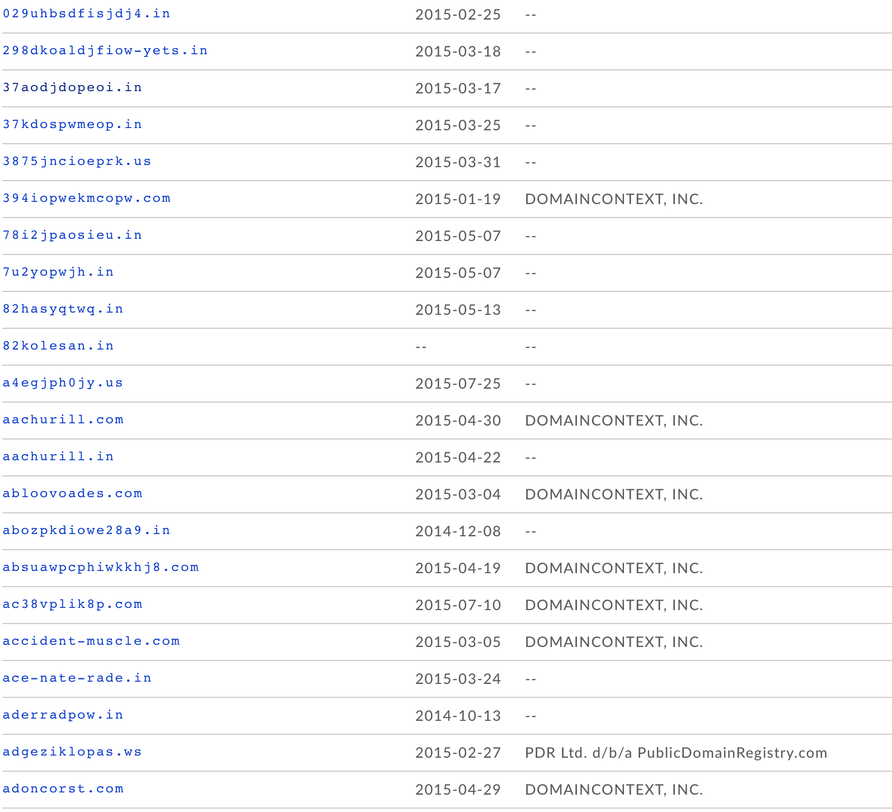
David Bowers

Slide 41
Surveillance is nice, what about notification?
Creation of feeds and intake is still a passive tactic.
It is all possible to automate notifications when key changes happen to allow for more near-time actions.
This uses the Pushover application (Apple and Google stores) which has a very simple API.

Slide 42
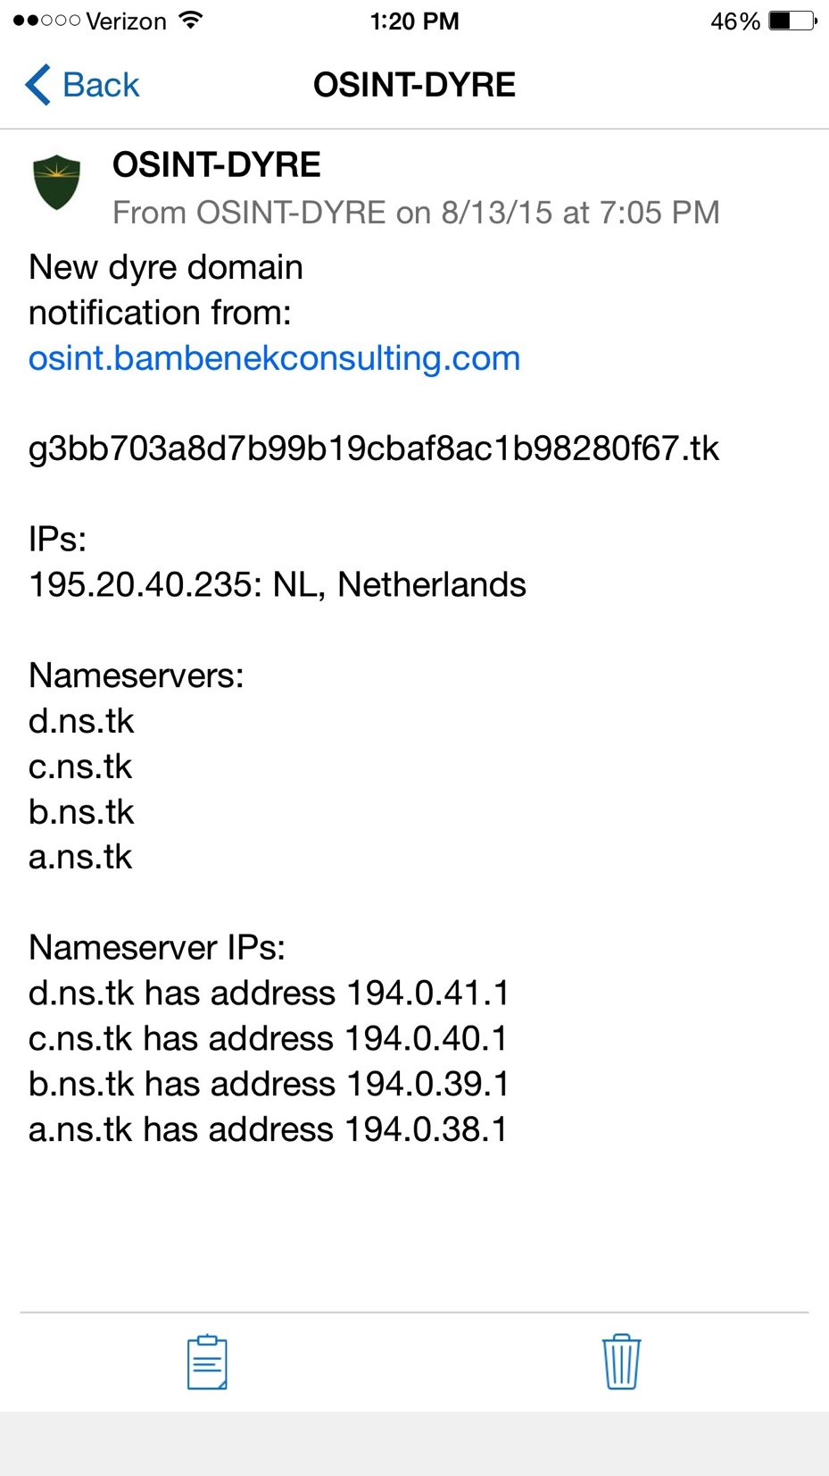
New Dyre domain registered

Slide 43
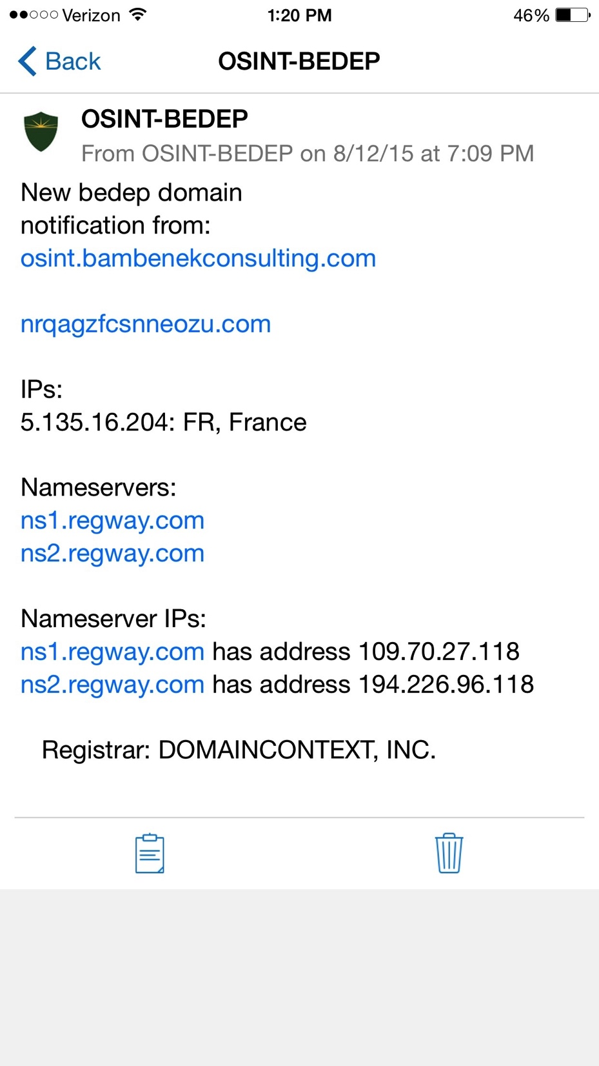
New Bedep Domain Registered

Slide 44
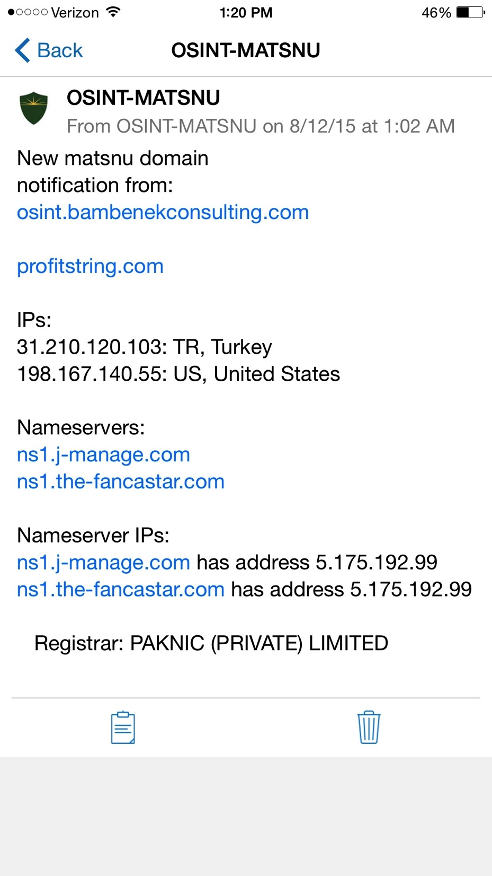
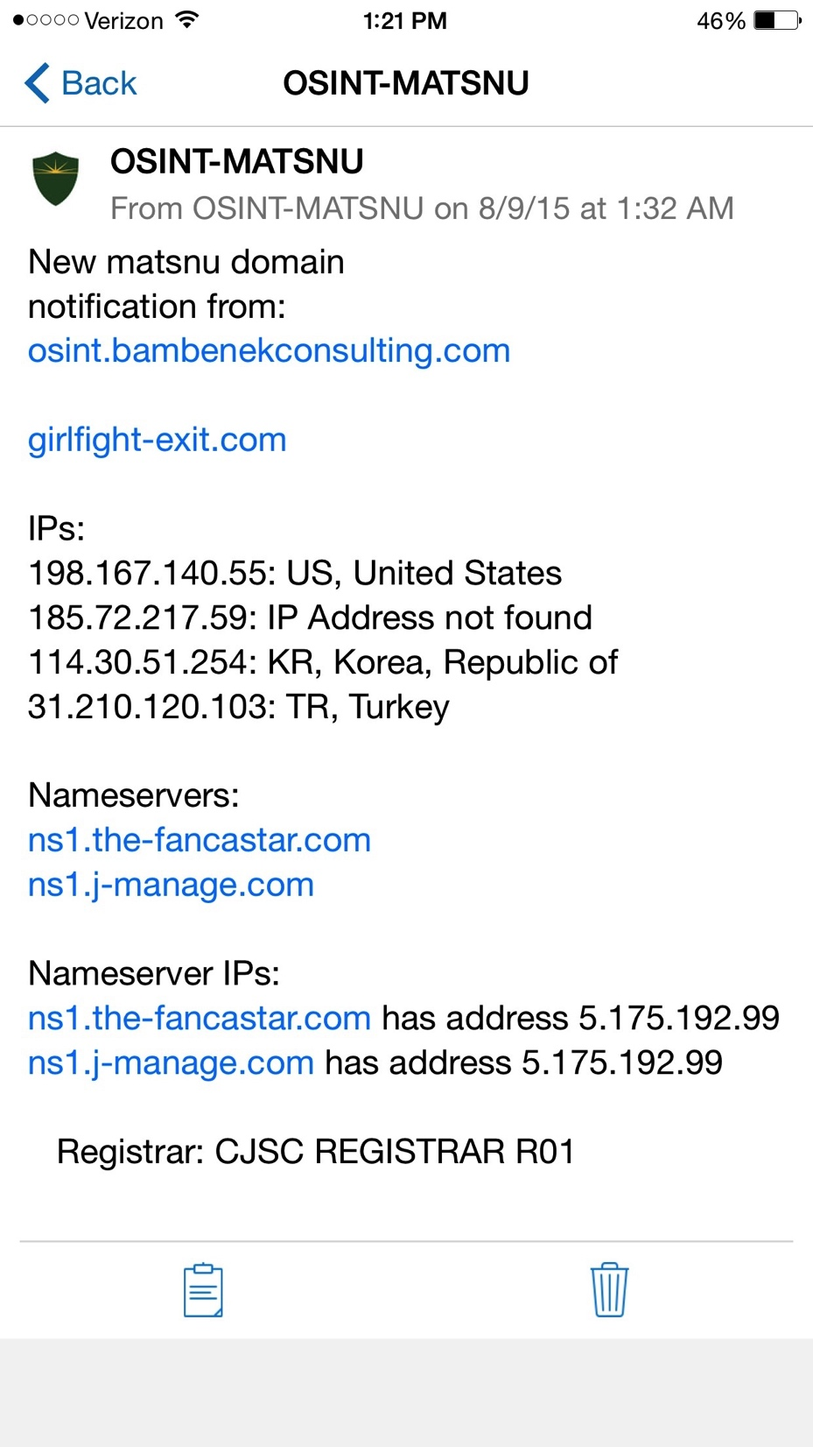
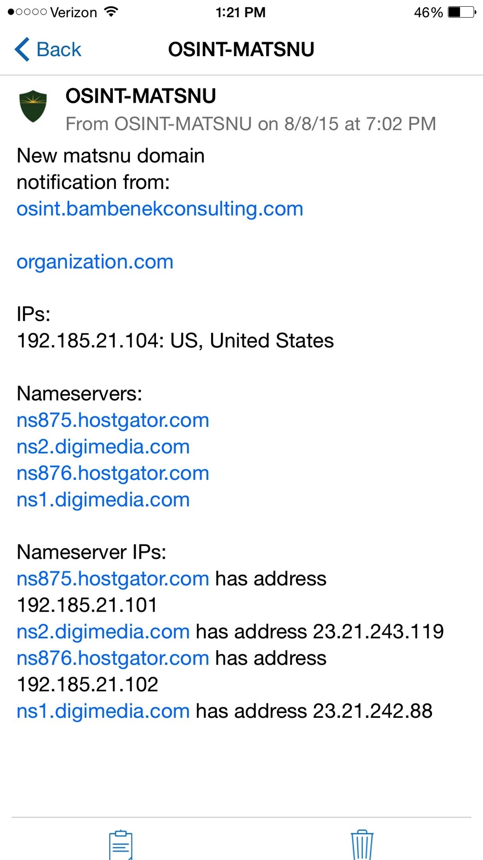
New Matsnu domains registered

Slide 45
Pivoting
Now that I know the-fancastar.com and j-manage.com serve NS for Matsnu, I can see what else is served by those nameservers to find additional intelligence.
As of 24 Aug, this has switched to nausoccer.net and kanesth.com
Caution is due, this may not always yield results and may yield false positives. Always correlate with something else before making a final judgement.

Slide 46
Pivoting
Using IP from Matsnu 31.210.120.103
hostkale.com. IN A 31.210.120.103
ns1.hostkale.com. IN A 31.210.120.103
ns2.hostkale.com. IN A 31.210.120.103
linuxtr.hostkale.com. IN A 31.210.120.103
mobiluzman.com. IN A 31.210.120.103
habertemasi.com. IN A 31.210.120.103
kinghackerz.com. IN A 31.210.120.103
eglencekeyfi.com. IN A 31.210.120.103
ns1.eglencekeyfi.com. IN A 31.210.120.103
nejdetkuafor.com. IN A 31.210.120.103
profitstring.com. IN A 31.210.120.103
sirketrehber.com. IN A 31.210.120.103
actstudy-meat.com. IN A 31.210.120.103
….

Slide 47
Last adversarial response
Starting to see sinkhole-aware malware.
Some malware always authenticated the C2, but sinkholes still could gather intel.
Now malware is being written to attempt to bypass sinkholes altogether.

Slide 48
The Future?
DGAs will be around for awhile as part of several methods of communication to victim machines.
Tor/I2P will continue to be used because of its advantages but DGAs still needed due to ease of blocking tor.
Increase in the use of “interesting” dynamic seeds.

Slide 49
Questions?
Thanks Daniel Plohmann, April Lorenzen, Andrew Abakumov, Anubis Networks, many others.
And thanks HITCON!
My feeds: osint.bambenekconsulting.com/feeds/
jcb@bambenekconsulting.com
www.bambenekconsulting.com
+1 312 425 7225

